Slide 1
Overview of flange connections for wafer valves for GEMÜ R470 Tugela
The hole pattern (oblong hole) of the wafer valve fits different connection types. The code of the largest flange connection is always given.
 |  | Nennweite
 |  | 50 | 65 | 80 | 100 | 125 | 150 | 200 | 250 | 300 | 350 | 400 | 450 | 500 | 600
Anschlussart | PN 10 | M | M | M | M | M | D | D | D | 2 | D | D | 2 | 2 | 2
 | PN 16 |  |  |  |  |  |  |  |  | D |  |  | 3 | 3 | 3
 | CL150 |  |  |  |  |  |  |  |  |  |  |  | D | D | D
 | PN25 |  |  |  |  |  | M | M | 5 | 5 | 5 | 5 | 5 | 5 | 5
 | PN40 |  |  |  |  |  |  |  |  | 6 | 6 | 6 | 6 | 6 | 6
 | CL300 |  |  |  |  |  |  |  | M | M | M | M | M | M | M

Slide 2
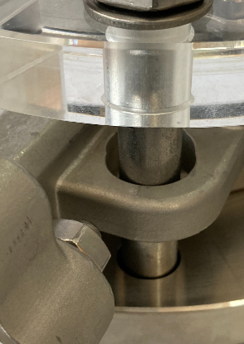
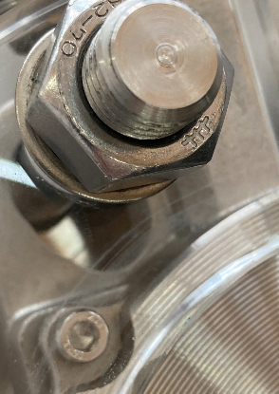
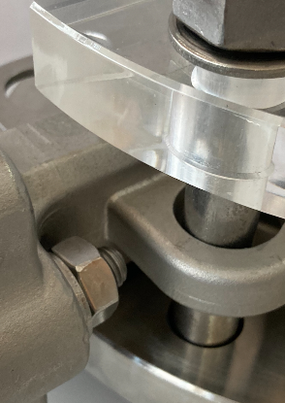
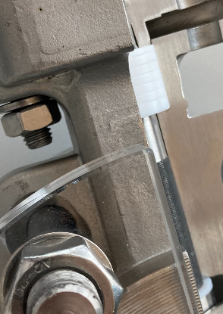

Slide 3
